Slide 1
Final Project Demo

Slide 2
Campus Event Management System
Manage campus events with different privileges for students and managers
Key features:
Manager dashboard
Event creation
Event enrollment
Event editing
Event cancellation
Google maps and calendar

Slide 3
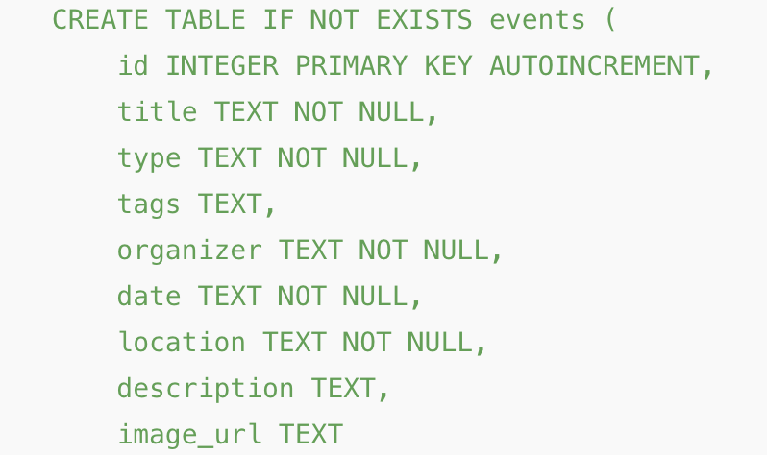
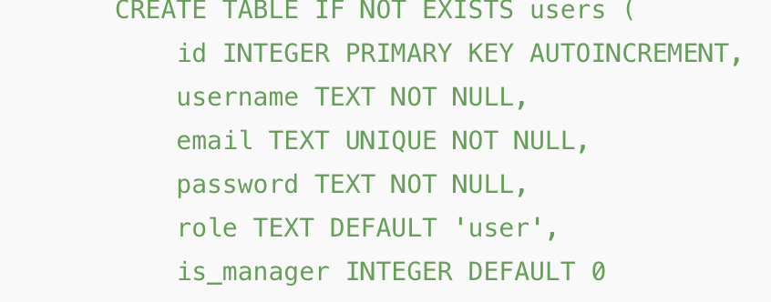
Database Structure
Tables:
Users
Stores username, email, password, roles (user and manager)
Events
Title, organizer, date, location, description, imahe
Signups
Links to events, enable participation tracking

Slide 4
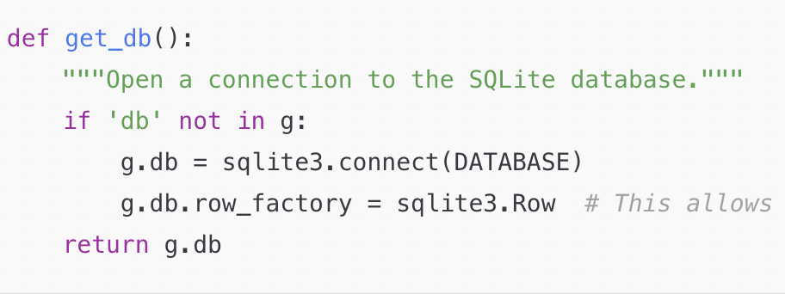
Database Connection Handling
Handles connections to the SQLite database using flask ‘g’ for persistent connections

Slide 5
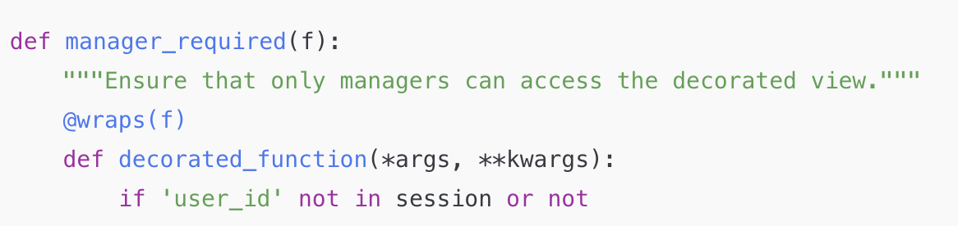
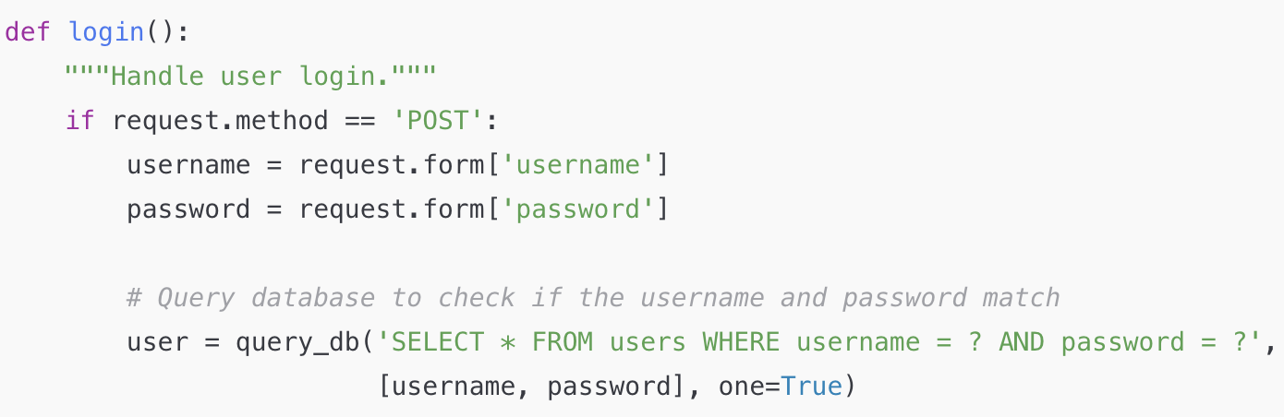
Authentication and Queries
Verifies identity of user by checking credentials during login
Query_db checks for matching username and password in the users table
If valid credentials are stored in the session to keep track of logged-in user

Slide 6
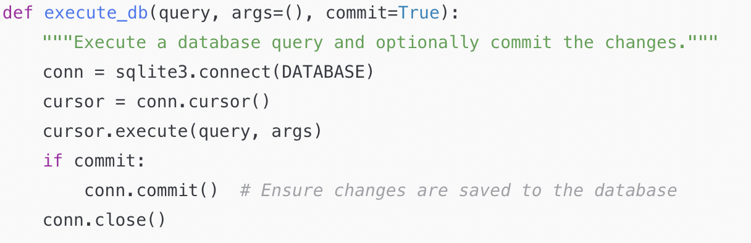
Executing database changes
Add the is_manager column to the users table for role-based access control
Is_manager INTEGER DEFAULT 0: Database update tracks if a user is a manager (using 1 for manager, 0 for regular user)
Enables role-based access so only managers can access admin features like creating or editing events
Notes:
Runs sql queries and involves executing an alter table query (modifies structure of existing tables - this case user table) to add the is manager column

Slide 7
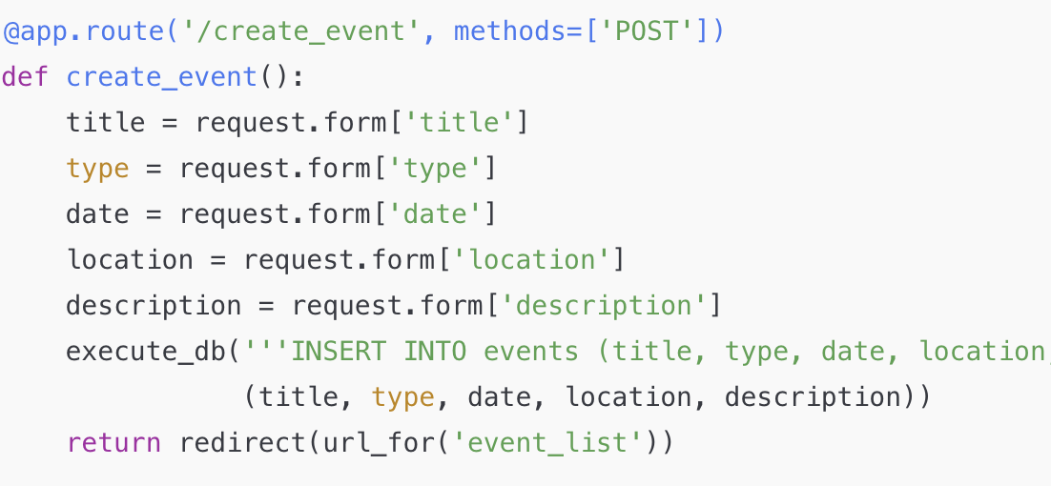
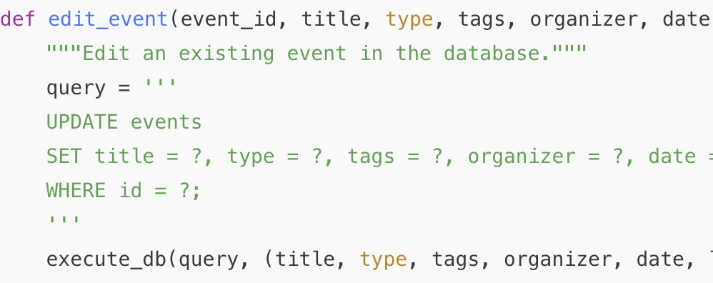
Event Creation/Management
Create and manage events though forms processed by flask routes connected to the database
Update SQL query modifies events table and updates record with the given event_id
Execute_db function handles execution of query

Slide 8
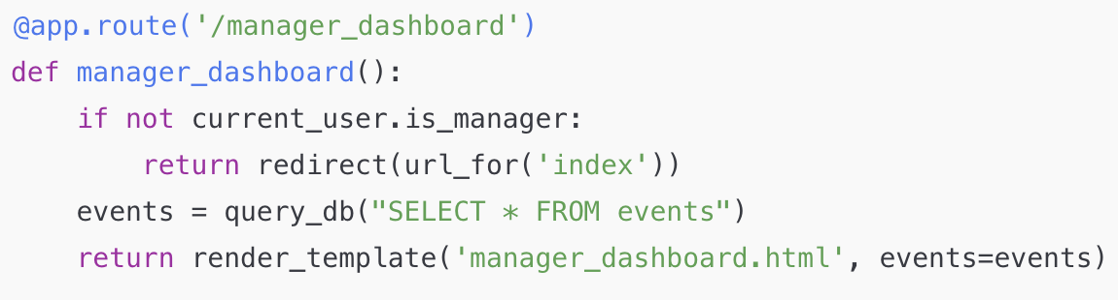
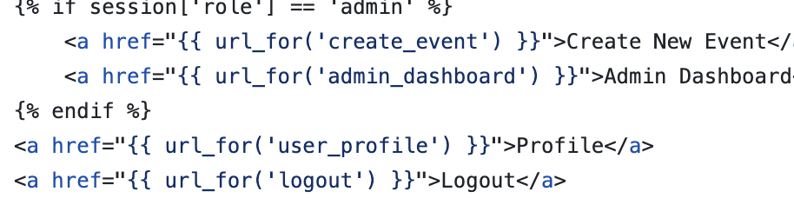
Manager/Admin Dashboard
Managers can view and edit event details
Can approve or reject event submissions

Slide 9
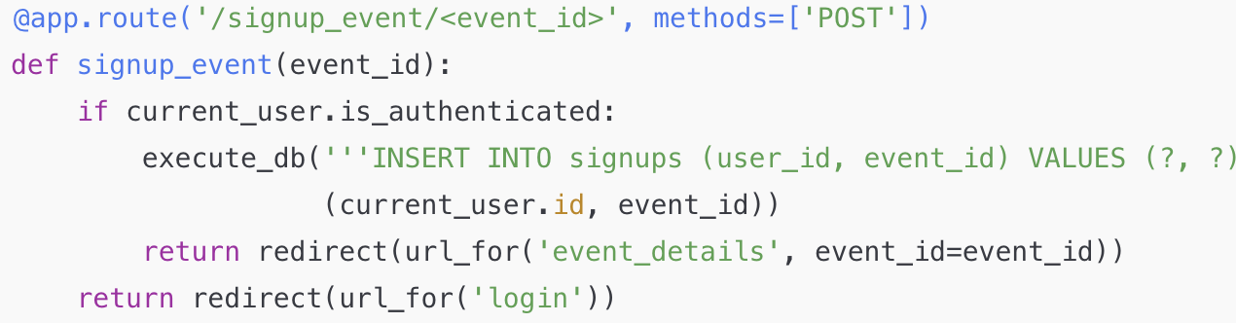
Event Signups
Users can sign up for events
Signups are tracked in the signups table

Slide 10
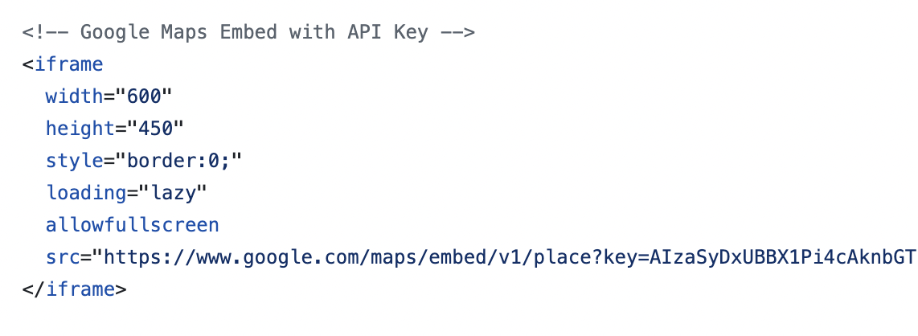
Google Maps
In event_details
Shows user the location/directions on google maps

Slide 11
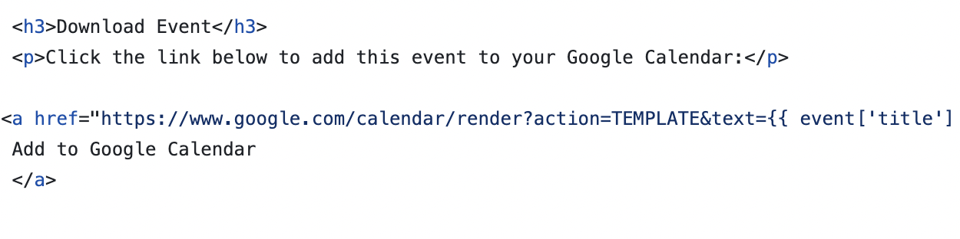
Google Calendar
Provides link to add the event to calendar
Automatically fills in date/time/location

